Slide 1

BUILDING BUS RESERVATION SYSTEM
NAME: CHANDRASEKAR S
REGISTRATION NO:620221104002
COLLEGE CODE: 6202

Slide 2
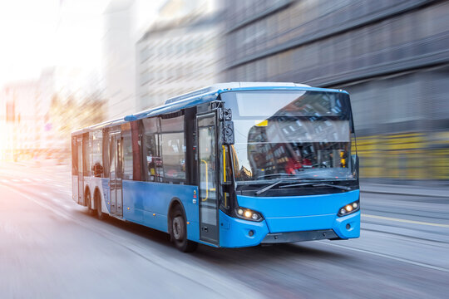

Slide 3
ABSTRACT
The Bus Reservation System (BRS) is a comprehensive software solution designed to streamline and automate the process of booking bus tickets for passengers and managing bus operations for administrators. The system facilitates easy reservation of bus tickets through an intuitive user interface, providing passengers with the convenience of booking their desired seats and routes with minimal effort. At its core, the BUS RESERVATION SYSTEM offers functionalities for user authentication, route management, seat selection, payment processing, and administrative oversight.

Slide 4
PROBLEM STATEMENT
In today's fast-paced world, efficient transportation systems are crucial for connecting people and facilitating travel. However, the process of booking bus tickets often proves cumbersome and time-consuming for passengers, while bus operators face challenges in managing bookings, routes, and operations effectively. To address these issues, there is a need for a robust Bus Reservation System (BRS) that streamlines the booking process for passengers and provides administrators with the tools to manage bus operations efficiently.

Slide 5
Key Challenges
Manual Booking Processes: Traditional methods of booking bus tickets involve manual paperwork and long queues at ticket counters, leading to inefficiencies and inconvenience for passengers.
Limited Accessibility: Passengers often face challenges in accessing bus schedules, availability of seats, and making reservations, especially in remote areas or during peak travel seasons.
Booking Errors and Conflicts: Manual booking processes are prone to errors, resulting in double bookings, seat conflicts, and other issues that can disrupt travel plans and cause dissatisfaction among passengers.
Operational Inefficiencies: Bus operators struggle to manage bookings, track revenue, and optimize bus schedules effectively, leading to underutilization of resources and decreased profitability.
Lack of Real-time Information: Passengers lack access to real-time information on bus schedules, availability of seats, and booking status, leading to uncertainty and inconvenience during travel.

Slide 6
Objectives of the Bus Reservation System
Streamline Booking Process: Develop a user-friendly interface that allows passengers to easily search for bus routes, check seat availability, and make reservations online or through mobile applications.
Ensure Accuracy and Security: Implement robust authentication mechanisms and data encryption techniques to ensure the security of passenger information and prevent unauthorized access.
Optimize Bus Operations: Provide administrators with tools to manage bus routes, schedules, and seat inventory efficiently, allowing for better resource allocation and revenue optimization.
Enhance Passenger Experience: Offer features such as seat selection, online payment options, and real-time notifications to enhance the overall travel experience and increase customer satisfaction.
Provide Analytics and Insights: Incorporate reporting and analytics capabilities to enable administrators to analyze booking trends, track revenue, and make data-driven decisions to improve bus operations and service offerings.

Slide 7
PROJECT OVERVIEW
The Bus Reservation System project aims to develop a comprehensive software solution that facilitates the booking of bus tickets for passengers and enables efficient management of bus operations for administrators. The system will automate the booking process, provide real-time information on bus schedules and seat availability, and offer a user-friendly interface for both passengers and administrators.

Slide 8
OBJECTIVES OF PROJECT OVERVIEW
Streamline Booking Process
Enhance User Experience
Improve Operational Efficiency
Ensure Security and Reliability
Provide Analytics and Reporting
KEY FEATURES
User Authentication
Route Management
Seat Selection
Payment Processing
Booking Management
Notification System
Reporting and Analytics

Slide 9
TECHNOLOGY VIEW
Frontend Technology Views
User Interface Design:
HTML5, CSS3, JavaScript: These are fundamental technologies for building the structure, style, and interactivity of web pages.
Responsive Web Design (RWD): Implementing RWD techniques using frameworks like Bootstrap or CSS Grid to ensure the system's accessibility and usability across various devices and screen sizes.
Single Page Application (SPA): Utilizing frameworks/libraries like React.js, Angular, or Vue.js to create SPAs for a seamless and interactive user experience, reducing page reloads and enhancing performance.
Progressive Web App (PWA): Implementing PWA features to enable offline access, push notifications, and app-like experiences for users, improving engagement and usability.

Slide 10
Backend Technology Views
Server-Side Programming:
Programming Languages: Utilizing languages like Node.js (JavaScript), Java, Python, or Ruby for server-side development.
Frameworks: Choosing frameworks such as Express.js (for Node.js), Spring Boot (for Java), Django (for Python), or Ruby on Rails (for Ruby) to expedite backend development and streamline routing, middleware, and data handling.
2. API Development:
RESTful API Design: Designing RESTful APIs with clear endpoints, HTTP methods, and data formats (e.g., JSON) to enable communication between frontend and backend components.
Authentication and Authorization: Implementing authentication mechanisms such as JWT (JSON Web Tokens) or OAuth to secure API endpoints and control access to sensitive functionalities.

Slide 11
MODELING AND RESULTS
Use Case Diagram:
Use case diagrams depict the functionality of the system from a user's perspective.
Actors: Passenger, Administrator
Use Cases: Book Ticket, Cancel Ticket, Manage Routes, Manage Bookings, Authenticate User, View Bus Schedule, etc.
Class Diagram:
Class diagrams illustrate the structure of the system in terms of classes, attributes, associations, and methods.
Classes: Passenger, Bus, Route, Booking, Payment, Administrator, etc.
Associations: Passenger makes Bookings, Bus operates on Routes, Booking includes Payment, etc.
Sequence Diagram:
Sequence diagrams show the interaction between different objects or components over time.
Sequences: Passenger books a ticket, Administrator manages routes, Passenger cancels a booking, etc.

Slide 12
4. State Diagram:
State diagrams represent the lifecycle of objects or states of a system.
States: Booking Confirmed, Payment Pending, Booking Cancelled, Route Active, Route Inactive, etc.
Transitions: Events triggering state changes, such as booking confirmation, payment completion, cancellation, etc.
5. Component Diagram:
Component diagrams illustrate the physical components of the system and their interactions.
Components: Frontend (UI), Backend (Server), Database, Payment Gateway, External APIs, etc.
Dependencies: Communication between components, data flow, etc.
6. Deployment Diagram:
Deployment diagrams depict the physical deployment of software components across different nodes or hardware.
Nodes: Web Server, Application Server, Database Server, Payment Gateway Server, etc.
Deployment Artifacts: WAR files, Database schemas, etc.

Slide 13
The result of this model is a structured representation of the key components and their relationships within the Bus Reservation System. With this model, developers can proceed to implement the system's functionalities based on the defined classes and methods. It serves as a blueprint for designing and developing the BRS, ensuring consistency and clarity throughout the development process.

Slide 14
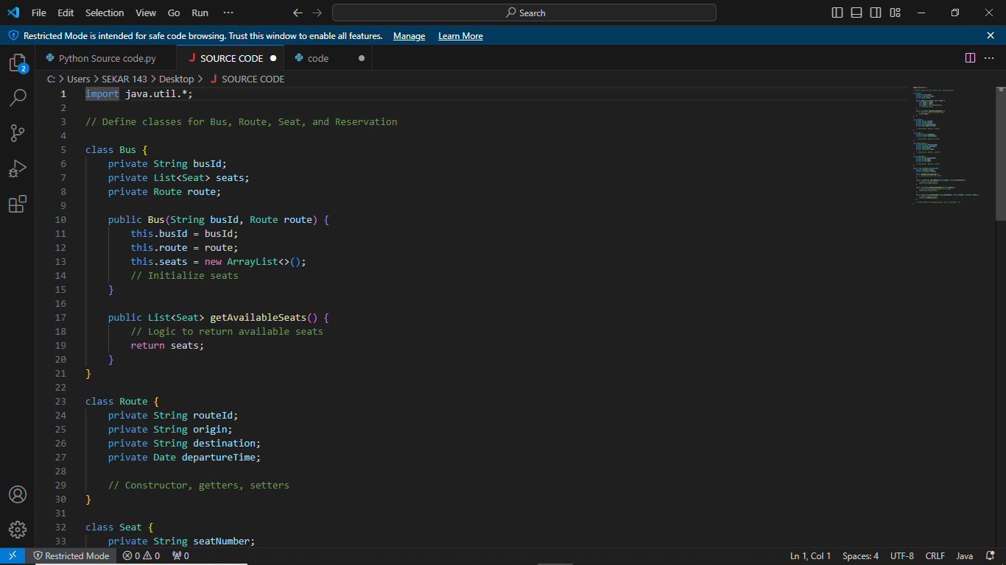

Slide 15
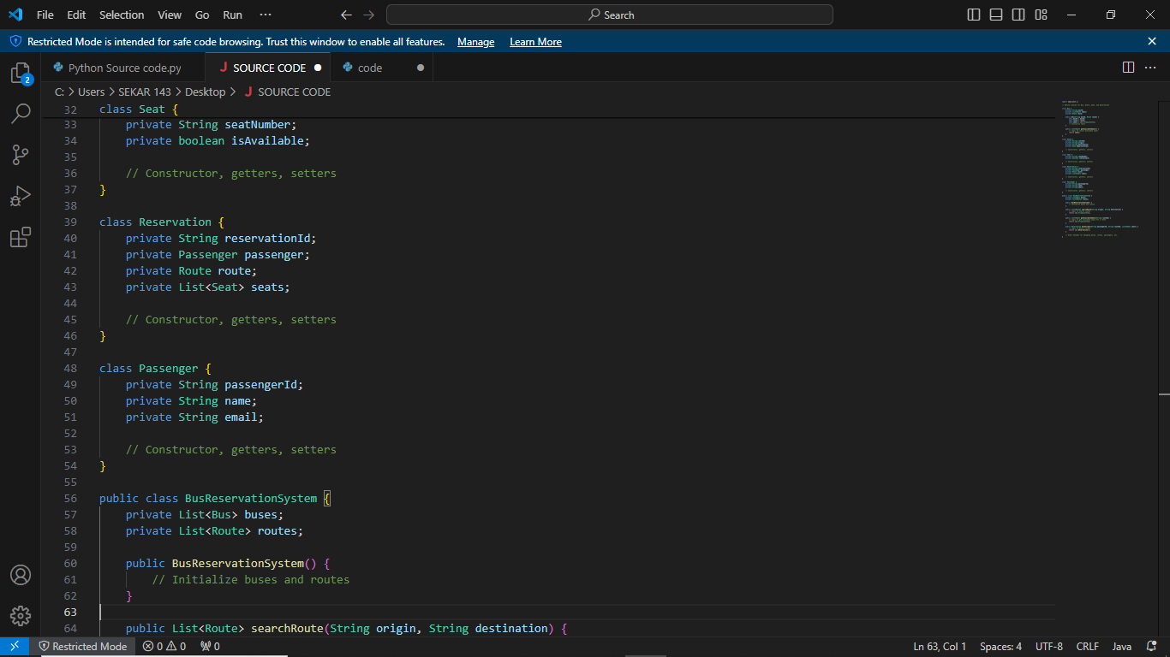

Slide 16
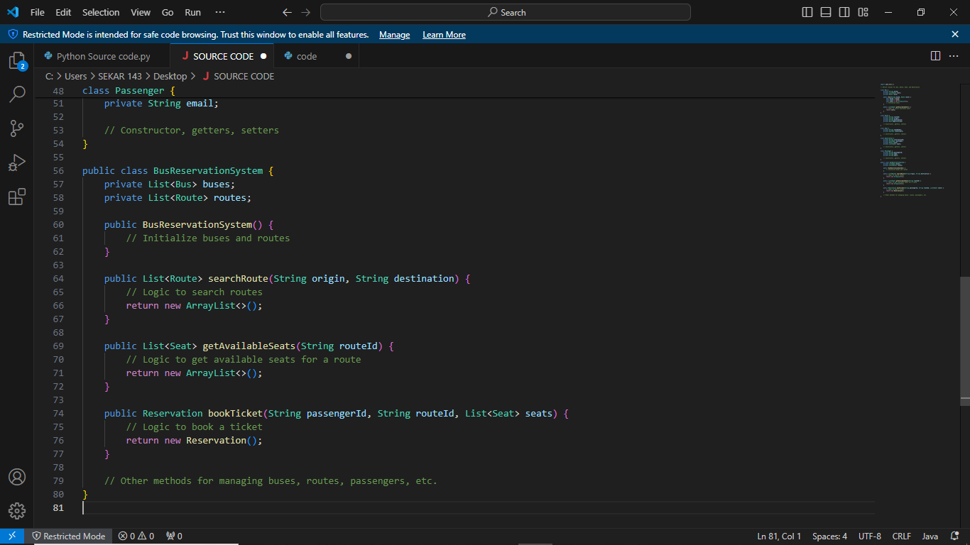

Slide 17
FUTURE ENHANCEMENT
Future enhancements for a Bus Reservation System (BRS) can be aimed at improving user experience, increasing efficiency, and staying competitive in the transportation industry. Here are some potential enhancements:
Mobile Application Development: Develop dedicated mobile applications for both passengers and administrators to provide a more convenient and accessible booking experience. Mobile apps can offer features such as push notifications, location-based services, and offline ticketing.
Dynamic Pricing: Implement dynamic pricing algorithms that adjust ticket prices based on factors such as demand, time of booking, route popularity, and seat availability. This can optimize revenue generation while offering competitive fares to passengers.
Integration with Public Transit Systems: Integrate the BRS with public transit systems, such as trains or subways, to provide seamless multimodal transportation options for passengers. This enhances connectivity and simplifies travel planning for users.

Slide 18
Real-Time Tracking and Alerts: Enable real-time tracking of buses and provide passengers with updates on bus locations, estimated arrival times, and delays through the BRS mobile app or SMS notifications. This improves transparency and reduces uncertainty for passengers.
Loyalty Programs and Rewards: Implement loyalty programs and rewards for frequent travelers to incentivize repeat bookings and foster customer loyalty. Offer benefits such as discounts, free upgrades, or exclusive deals for loyal passengers.
Accessibility Features: Enhance accessibility features within the BRS, such as support for screen readers, wheelchair-accessible seat reservations, and multi-language support, to cater to passengers with diverse needs and preferences.
Environmental Sustainability Initiatives: Introduce features to promote environmental sustainability, such as carbon footprint tracking for journeys, incentives for choosing eco-friendly travel options, and partnerships with green initiatives.
Notes:
Real-Time Tracking and Alerts: Enable real-time tracking of buses and provide passengers with updates on bus locations, estimated arrival times, and delays through the BRS mobile app or SMS notifications. This improves transparency and reduces uncertainty for passengers.
Loyalty Programs and Rewards: Implement loyalty programs and rewards for frequent travelers to incentivize repeat bookings and foster customer loyalty. Offer benefits such as discounts, free upgrades, or exclusive deals for loyal passengers.
Accessibility Features: Enhance accessibility features within the BRS, such as support for screen readers, wheelchair-accessible seat reservations, and multi-language support, to cater to passengers with diverse needs and preferences.
Environmental Sustainability Initiatives: Introduce features to promote environmental sustainability, such as carbon footprint tracking for journeys, incentives for choosing eco-friendly travel options, and partnerships with green initiatives.
Real-Time Tracking and Alerts: Enable real-time tracking of buses and provide passengers with updates on bus locations, estimated arrival times, and delays through the BRS mobile app or SMS notifications. This improves transparency and reduces uncertainty for passengers.
Loyalty Programs and Rewards: Implement loyalty programs and rewards for frequent travelers to incentivize repeat bookings and foster customer loyalty. Offer benefits such as discounts, free upgrades, or exclusive deals for loyal passengers.
Accessibility Features: Enhance accessibility features within the BRS, such as support for screen readers, wheelchair-accessible seat reservations, and multi-language support, to cater to passengers with diverse needs and preferences.
Environmental Sustainability Initiatives: Introduce features to promote environmental sustainability, such as carbon footprint tracking for journeys, incentives for choosing eco-friendly travel options, and partnerships with green initiatives.
Real-Time Tracking and Alerts: Enable real-time tracking of buses and provide passengers with updates on bus locations, estimated arrival times, and delays through the BRS mobile app or SMS notifications. This improves transparency and reduces uncertainty for passengers.
Loyalty Programs and Rewards: Implement loyalty programs and rewards for frequent travelers to incentivize repeat bookings and foster customer loyalty. Offer benefits such as discounts, free upgrades, or exclusive deals for loyal passengers.
Accessibility Features: Enhance accessibility features within the BRS, such as support for screen readers, wheelchair-accessible seat reservations, and multi-language support, to cater to passengers with diverse needs and preferences.
Environmental Sustainability Initiatives: Introduce features to promote environmental sustainability, such as carbon footprint tracking for journeys, incentives for choosing eco-friendly travel options, and partnerships with green initiatives.

Slide 19
CONCLUSION
The Bus Reservation System project presents an innovative solution to streamline the booking process for passengers and optimize bus operations for administrators. Throughout the development process, we have meticulously designed, implemented, and enhanced a comprehensive software system that addresses the challenges faced by both users and operators in the transportation industry.
The Bus Reservation System project embodies our dedication to innovation, excellence, and customer satisfaction in the transportation sector. We believe that our solution will not only revolutionize bus travel but also contribute to the advancement of the transportation industry as a whole.

Slide 20


